Slide 1

Using the Toolkit to Boost Contributions & Build Homes
Presented by Sarah Jimenez, Paschal Roth Public Affairs
October 23, 2018

Slide 2
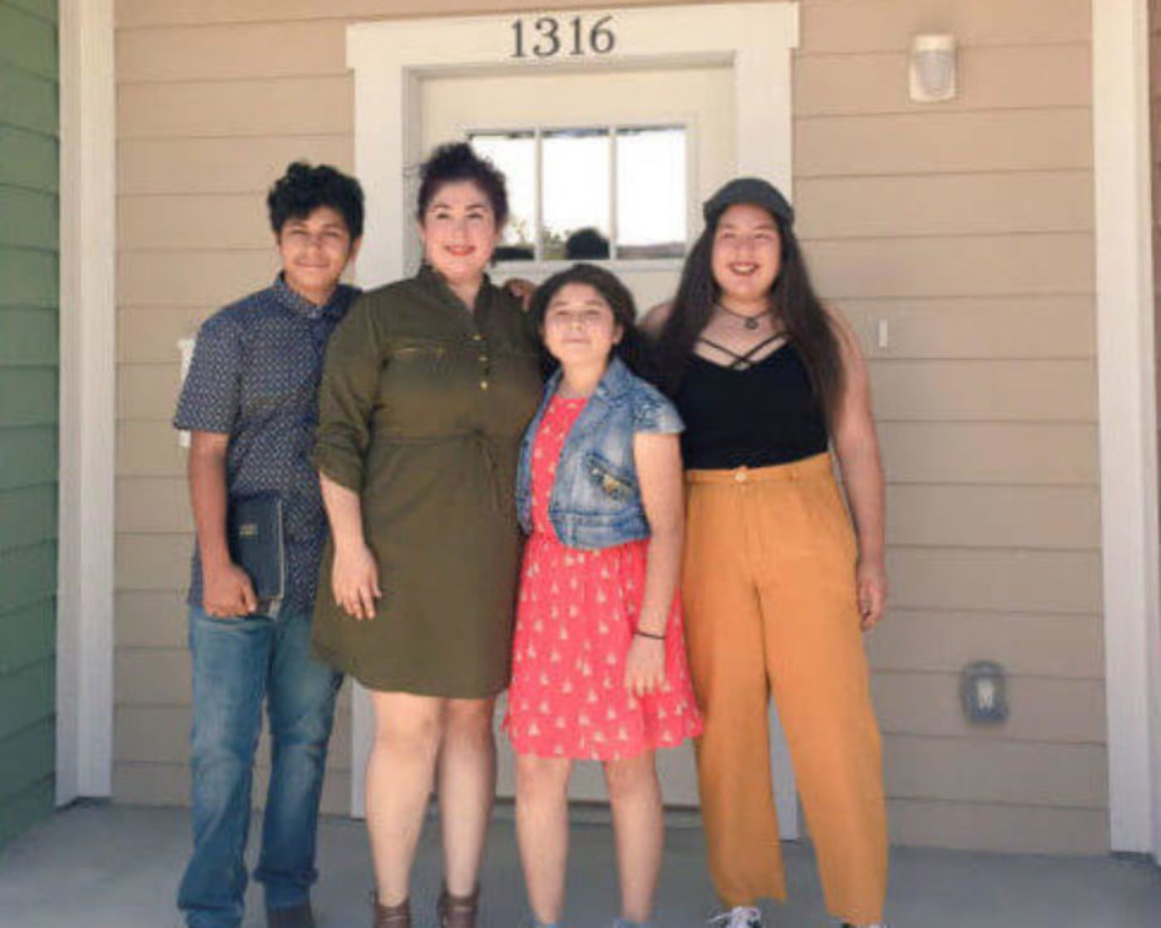
Build Homes Build Hope Campaign Goals
    Raise $250,000 via contributions from California tax filers in 2019
    Empower affiliates to raise funds that stay local to build homes in your community
Notes:
1. Habitat for Humanity California must raise $250,000 via contributions from California tax filers in 2018.
2. Empower all affiliates to partake in the campaign to raise funds to build affordable homes AND because funds stay local. You get $ from your zip code.

Slide 3

Challenging Fundraising “Ask”
    Lag time between commitments and action
    Indirect mechanism
    Complicated ask
Notes:
The tax contribution fundraising campaign is logistically challenging as far as fundraisers go –
Lag time -- we have to get people to commit, then follow through at a later point when they’re filing their taxes
No direct mechanism for tracking or follow-up – we don’t know when people are filing or who they are -- they won’t get a “thank you” or any follow up once they contribute
Complicated ask –can’t just click to contribute, and the process isn’t easy to explain
they have to find the right section of the tax form, and enter an amount on the right line… all when they’re likely stressed or overwhelmed about taxes

Slide 4
Keys to Success
Affiliate leadership is crucial to the campaign’s success
  Early education in your networks
  On-going outreach and use of key messages and materials
  Consistency and energy in messaging
Notes:
With a limited budget for paid advertising, the campaign will rely heavily on reaching out to existing donors, volunteers, partner organizations, and others who have a relationship with a local habitat affiliate.
Your affiliates’ full involvement in the campaign is essential.
We are counting on you to use your communications channels to deploy the campaign’s messaging EARLY, OFTEN, and CONSISTENTLY.
We will provide the tools you need – but we can’t amplify this campaign without you.

Slide 5
How Voluntary Tax Contributions Work
Californians choose to donate part of their annual tax return to Habitat for Humanity California through the Habitat for Humanity Voluntary Tax Contribution Fund
They can contribute $1 or more to the fund up to the full amount of their tax return
The donation is tax deductible when you file your taxes the following year
Habitat for Humanity California affiliates receive the amount donated from donors in their zip codes

Slide 6

Key Messages
  Build homes and hope with your state tax return today.
  Everyone can help! With as a little as $1, and without even picking up a hammer, Californians have the opportunity to build a world where everyone has a decent place to live.
  Funds stay local! Funds help build homes for families in need of affordable housing in your community.

Slide 7

Email Campaign
  Your email list is a powerful tool!
  Key Audiences:
    Volunteers
    Donors
    Habitat for Humanity California Homeowners
  Customize email messages to each group
  Ask people to share with 5 friends
Notes:
You are 6x more likely to get a click-through from an email campaign than you are from a tweet.
Email marketing drives more conversions than any other marketing channel, including search and social.
A message is 5x more likely to be seen in email than via Facebook.
Example of custom message: Homeowners – You’ve shared many times with us how much building and having an affordable home has changed your life. Consider sharing your story with 5 friends today and let them know they can help build homes and hope for families too… with as little as $1 on their California tax return. Yep, you, your family and friends can make a contribution to Habitat for Humanity California this tax season on your state tax return. Learn more at www.habitatca.org/taxfund/
*https://www.campaignmonitor.com/blog/email-marketing/2016/01/70-email-marketing-stats-you-need-to-know/

Slide 8
Exercise
1.
2.
3.
Name three organizations you can ask to share the campaign’s sample email with their lists (in addition to your own)

Slide 9
Outreach Toolkit
Packed with tools YOU – affiliates – need to spread awareness in community via social media channels, local media outlets and on your websites, linking people to www.habitatca.org/taxfund

Slide 10
Contribution Reminder Form
Why use a form?
  Important way to remind people how to donate, whether they file taxes themselves or with tax preparer
Tax filers can print this reminder form and keep it with their tax materials
Spanish form to come

Slide 11
Sample
Newsletter
A Newsletter is great opportunity to kick off the campaign
Customize the write-up to inform subscribers to your newsletter
Note the tell 5 friends – sharing is key!

Slide 12
Sample
Press Release
Informing your local media (TV, Radio or Newspapers) about the campaign can work particularly well in small to medium markets
Can lead to potential success stories too!

Slide 13
Sample Letter to the Editor
See a housing crisis story in your local paper? Great opportunity to respond, link and pivot to the campaign
Let readers know in succinct way about the need to build homes and how to support your efforts through this sample Letter to the Editor
Notes:
Think about your messenger – how do you get your volunteer, Board member and Habitat homeowners engaged at various points between Jan-Apri?

Slide 14
Sample
Opinion Piece
See a housing crisis story in your local paper? Again, connect the dots for readers and pivot to campaign
Longer format allows you to provide more details about your affiliate, your success, the tax fund, and a local family story

Slide 15


Sample Social
Media Posts
Use the power of your social media followers! Graphics and sample messages to lay the groundwork are in the toolkit
Photos and videos are a must!
Post when most people are online: 11AM-1PM or 6-7PM

Slide 16


Social Media Images
Facebook Cover Photo
Twitter Cover Photo
Account Profile Photo

Slide 17
Exercise
1.
2.
3.
Name three ways your affiliate can commit to doing outreach about the Voluntary Tax Contribution Fund campaign

Slide 18
Campaign Timeline
Early November - Send email to your list about the start of the campaign. Direct recipients to the habitatca.org/taxfund website for more information.
November/December – Send contribution reminder form in your end of the year donation letters. Available at habitatca.org/tax-action.
Early December – Send email to list about this unique way to donate. Direct recipients to the habitatca.org/taxfund website for more information.
Throughout November/December – Via social media channels –highlight Habitat for Humanity’s good work – families who have new homes, work your affiliate is doing in the community, etc.

Slide 19
Campaign Timeline
Early January – Send email to list highlighting it’s tax paperwork collecting season, W-2s are rolling in, add our tax pledge form to your stack. Direct recipients to habitatca.org/taxfund for more information.
Superbowl Weekend (February 3, 2019) – We see a lot of DIY tax ads – use that as “hook” for email, newsletter or social.
Every other week starting late February – April – Send emails or newsletter items about the campaign, include stories of families your affiliate has helped. Direct recipients to habitatca.org/taxfund for more information.

Slide 20
Campaign Timeline
Beginning of April – Send email to list reminding them taxes are due April 15, 2019 and don’t forget the Voluntary Tax Contribution Fund.
Second week of April – Another opportunity for a friendly countdown to Tax Day and how to Build Homes and Hope.
Tax Day – April 15, 2019 – Be the email people are happy to receive on Tax Day and do a last push for the Voluntary Tax Contribution Fund.

Slide 21

NOTE!
There is no “box” on Form 540 in the Voluntary Tax Contribution Fund section
Californians must fill in a line with the amount they want to donate

Slide 22

Campaign & Public Information: www.habitatca.org/taxfund
Toolkit: www.habitatca.org/tax-action

